Slide 1
MATLAB and Keysight Scopes
Diego Sena and members
Summer 2023

Slide 2
Agenda
Goals and objectives
So What? why is this important?
Plan of Record
Test plan
Literature search and background

Slide 3
Goals and Objectives
Control the KEYSIGHT Scope with MATLAB
Analyze the bandwidth of the scope and scope cables

Slide 4
So What? Why is this important
To characterize the maximum frequency sampleable by the scope and scope cables

Slide 5
Plan of Record
What is your SDI? KeySight scopes
What does it mean to “work”: Compare Bandwidth of different scopes and cables and find their Nyquist frequencies.
Test plan- how will you validate that it “works”? Use a scope with a known bandwidth and compare the Nyquist cut off.
What is the killer app: Bandwidth analyzer
Examples of some of the actions you might take
A rough schedule: week by week until your presentation date, or Aug 11.

Slide 6
Test Plan
What are the specifications you will test to: what does it mean to “work?”
Can accurately collect and process data and produce and FFT
What will you measure?
1Vpp 30 MHz Sin Wave
What are the tests you will do?
What is a measure of success?

Slide 7
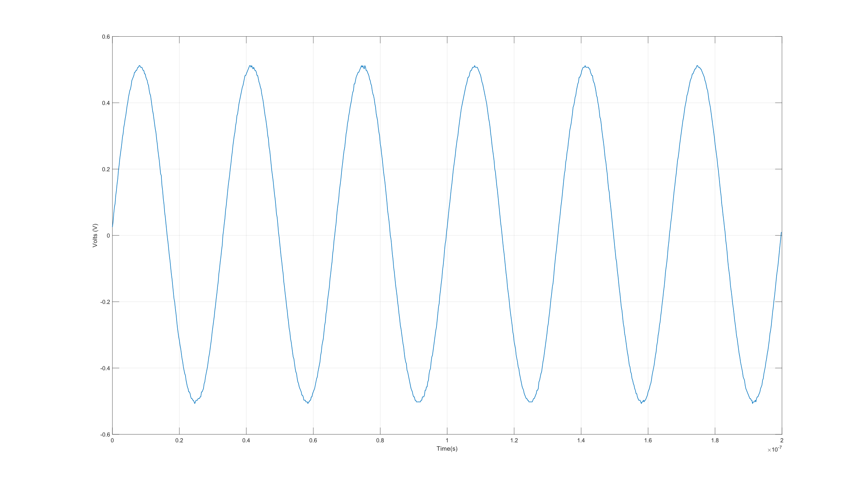
30 MHz Sin Wave

Slide 8
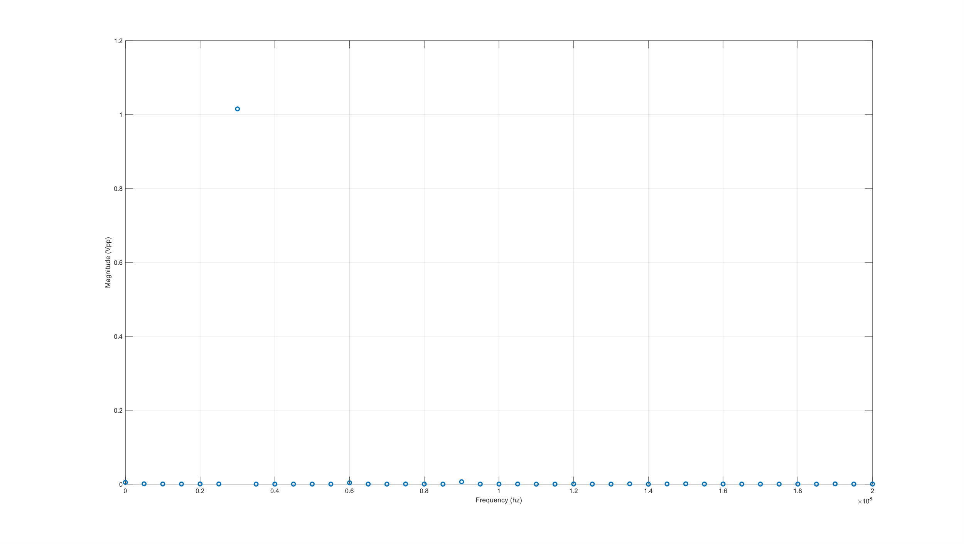
30 MHz Sin Wave FFT

Slide 9
Literature Search, Background
Understand DFT and FFTs
IVI library
Matlab

Slide 10
What was accomplished last week
Connected the computer and scope
Pull data from the scope
Plot data from the scope
Analyze data from the scope

Slide 11
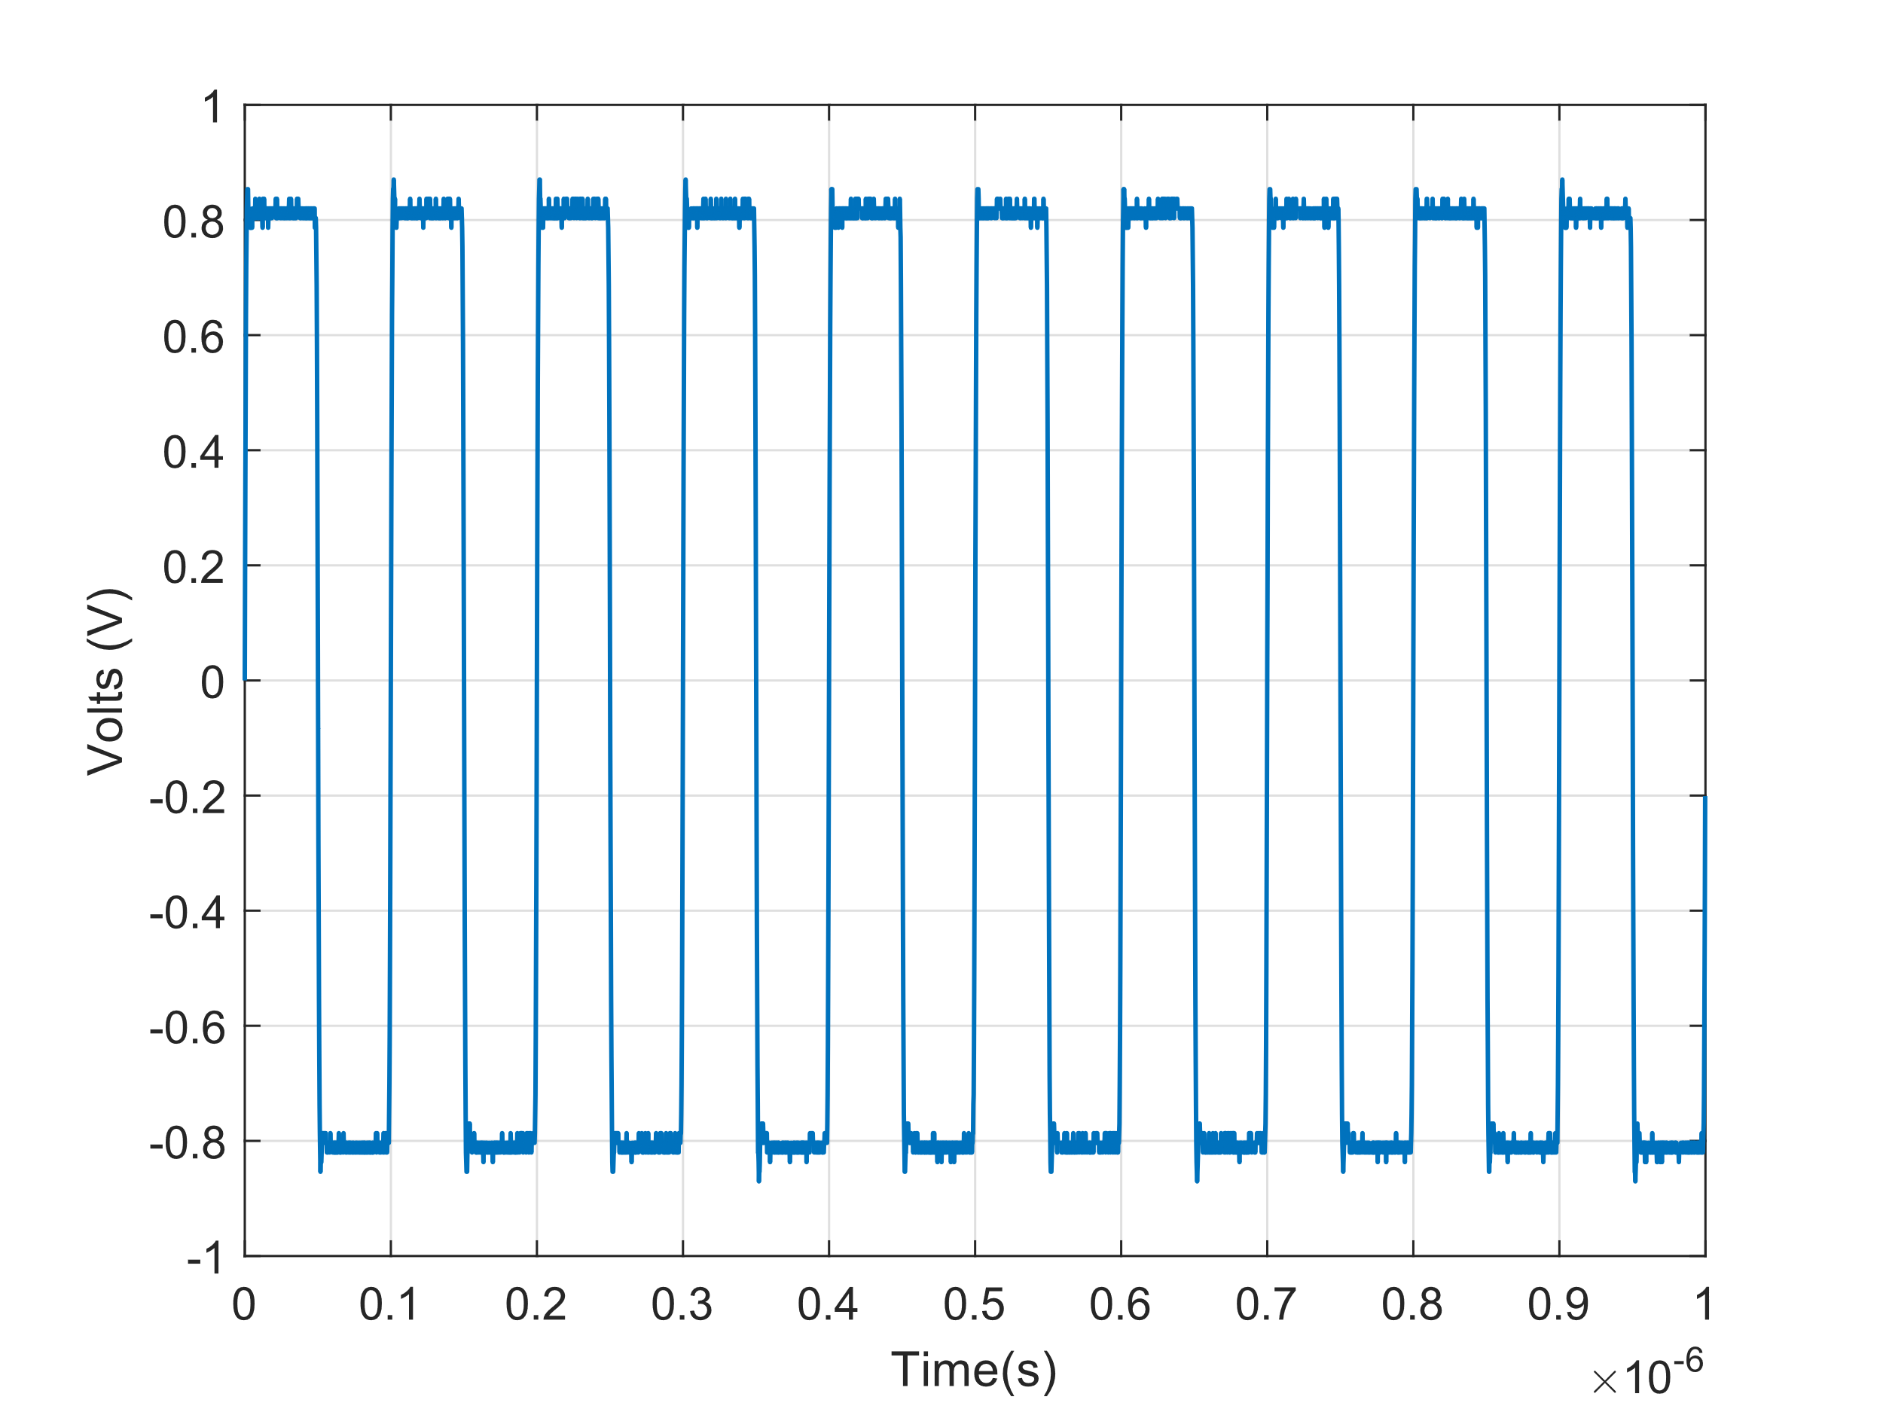
Square Wave From Scope

Slide 12
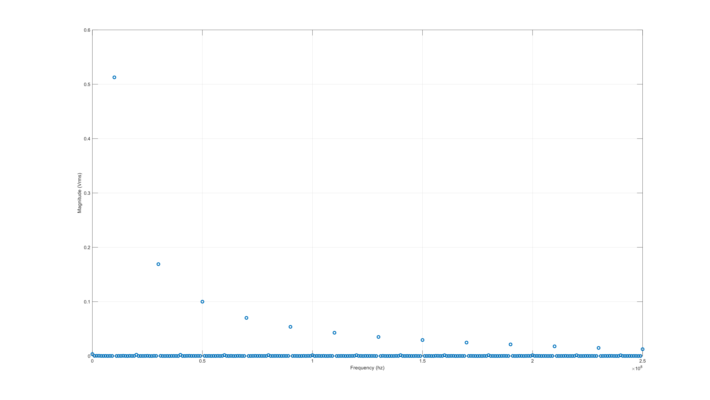
FFT of Square Wave

Slide 13
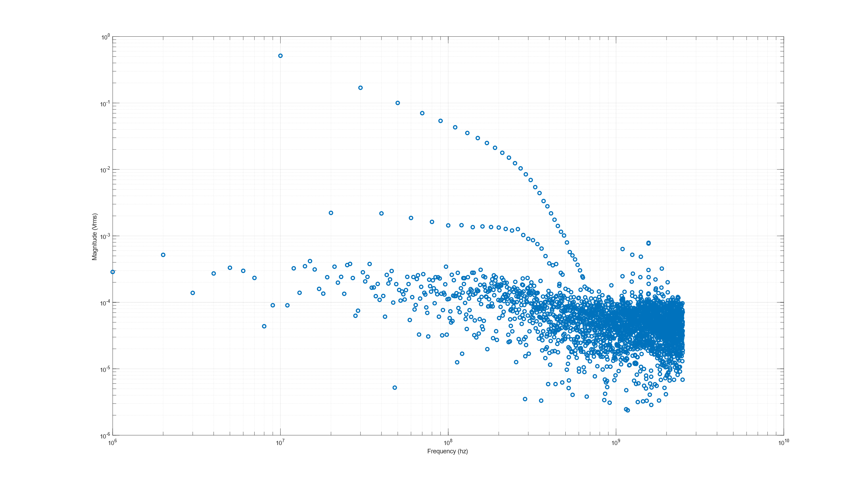
LogLog FFT of Square Wave

Slide 14
What is planned next week

Slide 15
Progress to the Goal

